Slide 1
Employee Wellness Program: Style Guide

Slide 2
Table of Contexts
Introduction…………………………………………………………………..3
Logotype………………………………………………………………………..5
Typography……….……………………………………………………………6
Colors…………………………………………………………………………….10
Icons……………………………………………………………………………...12
App name and icon………………………………………………………...13
Examples……………………………………………………………..…………14
Don’ts……………………………………………………….…………………...15
Additional information……………………………………………………16

Slide 3
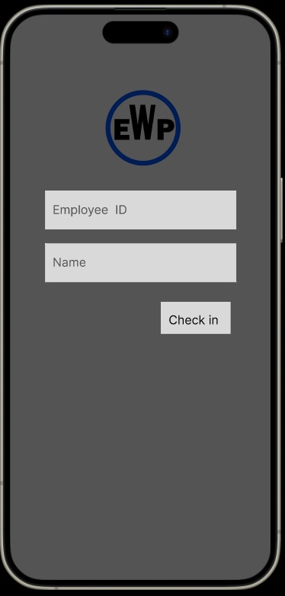
Introduction
To preserve the quality of our mobile application, it is very important that those who wish to replicate follow these guidelines.
For detailed instructions on the application of all brand assets such as wordmark, symbol, logo types, color and typography please refer to our main website.

Slide 4
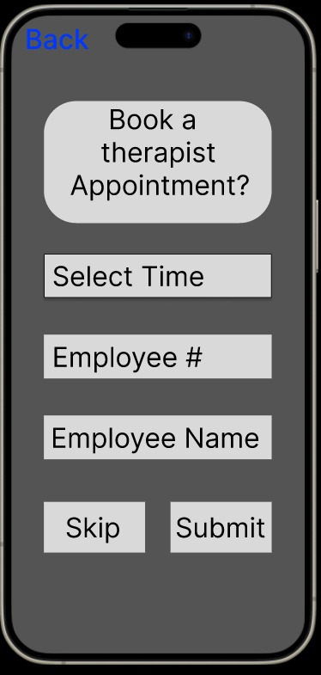
Introduction cont.
Preparations
Apps that are part of EWP mobile apps must follow the designs in this manual. Before publishing an app, EWP and the Identity team needs to approve the publication.

Slide 5
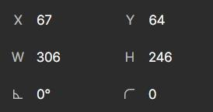

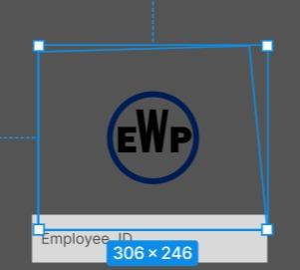
Logotype
Portions, Logos, and Sizes
The symbol for EWP is placed at the top of the login screen which is the only place this logo is being used making it easy to incorporate
For tablets that are especially in landscape mode, the logo should be the same principal.
The size of the logo on the welcome page and the location of the logo relative to the screen
The dimensions from the center of the screen should never change when building the welcome page
EWP logo

Slide 6
Typography
Typography Settings
Headline: DM Sans Bold
Font size mobile: 24px and up
Text: upper and Lowercase
Letter Spacing: 0
2. Subheadline: DM Sans Bold, or Medium
Font size mobile: 18px and below
Text: Upper and Lowercase
Letter Spacing: 0
3. Bodycopy: B612 Regular
Font size mobile: 14px and below
Text: Upper and Lowercase
Letter Spacing: 0
4. Labels: B612
19px and below
Text: Upper and Lowercase
Letter Spacing: 0
For headlines DM Sans is used. It is available as Bold (first hand choice for main headlines), Medium(for moderate headlines), and Regular (for longer headlines or sub-headlines).
For subheadlines DM Sans is used. It is available as Bold (first hand choice for main headlines), Medium(for moderate headlines), and Regular (for longer headlines or sub-headlines).
For bodycopy and labels B612 is used. It is available as Bold (first hand choice for main headlines),and Regular (for longer headlines or sub-headlines). It is also available in Italic and bold italic.

Slide 7
Typography cont.
Headlines: DM Sans – Bold
Headlines: DM Sans - Medium
Headlines: DM Sans – Regular
abcdefghijkImnopqrstuvxyzäö
1234567890!"#€%&/()=?
abcdefghijkImnoparstuvxyzäö
1234567890!" #€%&/()=?
abcdefghijkImnoparstuvxyzäö
1234567890!'#€%&/()=?
Subheadlines: DM Sans - Bold
Subheadlines: DM Sans - Medium Subheadlines: DM Sans - Regular
abcdefghijkImnoparstuvxyzäö
1234567890!'#€%&/()=?
abcdefghijkImnoparstuvxyzäö
1234567890!"#€%&/)=?

Slide 8
Typography cont.
Labels and Boycopy: B612 - Bold
Labels and Boycopy: B612 - Regular
abcdefghijkmnoparstuxyzäo
1234567890!'#€%&/[J=? ←Bold Italic
abcdefghijklmnopqrstuvxyzäö
1234567890!" #€%&/[]=? ←Regular Italic

Slide 9
Typography cont.
Replacement Fonts
If there is a case that the aforementioned primary fonts are not available, it is instructed that you use:
Arial - Headlines andSubheadlines
Calibri - Labels and bodycopy
Arial - Headlines and Subheadlines
abcdefghijk|mnoparstuvxyzä
ö1234567890!'#€%&/()=?
Calibri - Labels and body copy
abcdefghijk|mnopqrstuvxyzäö1
234567890!'#€%&/()=?

Slide 10
Colors
Logo Colors:
EWP Color Palette
The EWP Color palette does not exclusively rely on the use of the logo colors or colors like it. The color palette mostly consists of dark colors like blue or black.
In mobile apps black or white are primarily used as background colors.
#001b53, RGB 0, 27, 83 Navy Blue
#001b53, RGB 0, 0, 0, Black
1
2
Primary Colors:
#001b53, RGB 0, 27, 83 Navy Blue
#001b53, RGB 0, 0, 0, Black
#D9D9D9, RGB 217, 217, 217, Grey
#24FF00, RGB 36, 255, 0, Green
#BDFF00, RGB 189, 255, 0, Lime
# FAFF00 , RGB 250, 255, 0, Yellow
# FAFF00 , RGB 250, 199, 0, Orange
# FAFF00 , RGB 255, 0, 0, Red
1
2
3
4
5
6
7
8

Slide 11
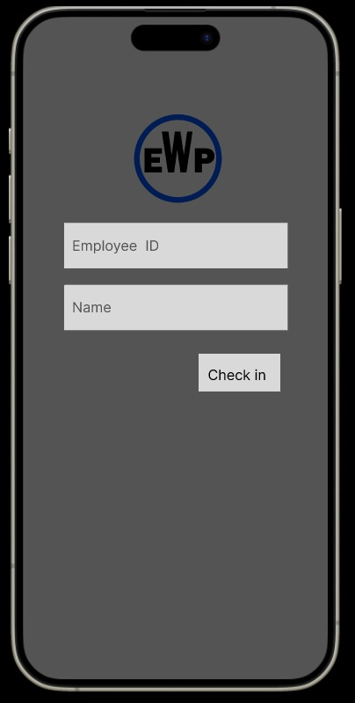
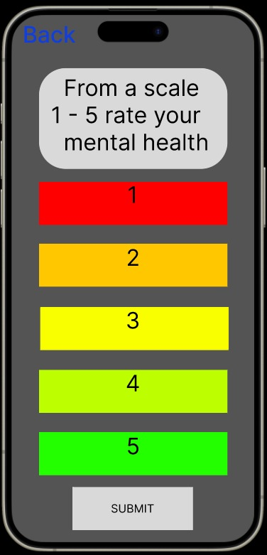
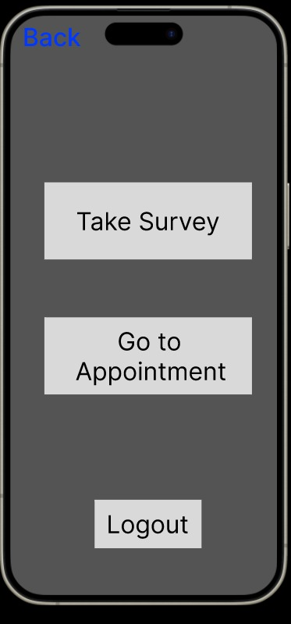
Colors Cont.

Slide 12




Icons
The icons that should be used should come from the "coolicons" library on Figama and the "Star Ratings library in Figma. Any other Miscellaneous icons will be located on the EWP primary website under development reference.

Slide 13
App name and icon
App Icon:
The app icon is the first impression and identity of the app and shall therefore represent the app's Purpose.
An app icon is unique and exclusive for its app and shall not be used for other purposes or meanings. Hence, for each new app, a new app icon is created. Never use the EWP symbol/logotype as app icon. The icon style is based on the the same design as for other EWP icons.
Process for approval:
Requests for new icon names and icons are handled by 3 Amigas Mobile. Send your request to inqueries@threeamigas.com together with the following information:
﻿Requester's name and e-mail address
﻿App availability ( Google Play and/or App Store)
﻿App information (purpose, context, target group etc.)
﻿Proposed name
﻿Proposed app icon (insert print screen/attach draft)
Principles for naming a new app:
When naming a new app, please make sure that the following principles are applied:
Be in line with the EWP brand
Express customer benefit
Focus on the functionality of the app
Be descriptive
Follow industry practice Be consistent (in context)
Be kept short
Relate to Caregiving or family
Be the same worldwide (English)

Slide 14
Examples
Demo App Examples:

Slide 15
Donts
EWP Colors
Don't use unapproved colors.
Don't reproduce any part of the EWP logotype in any other color than the original color
Other Important don'ts
Don't use the icons for decoration or as logotypes.Only use the icons for information.
Don't reuse app icons. Each icon is unique for each app
Don’t reinvent the app icon or templates or change the margins
Do not reinvent the EWP logo
Do not use any unapproved icons

Slide 16
Additional Information
Additional Information
If you have any questions, comments, concerns or complaints regarding stylistic details, please contact us at:
EWPquestions@EWP.com
Or
EmployeeWellness.tech@EWP.com

